Slide 1
Movie Recommender
IST - 736
Gianni Conde
Sahil Nanavaty
Sana Khan

Slide 2
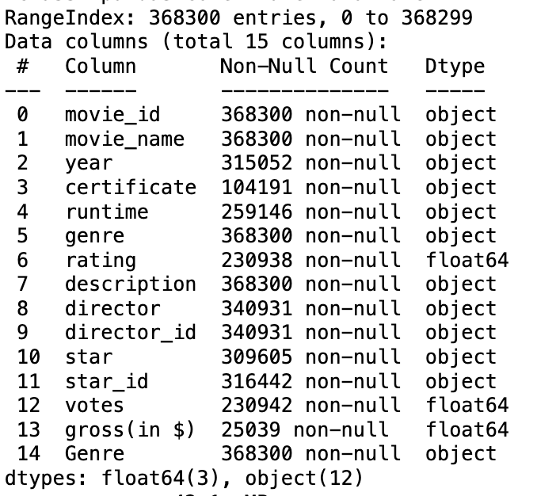
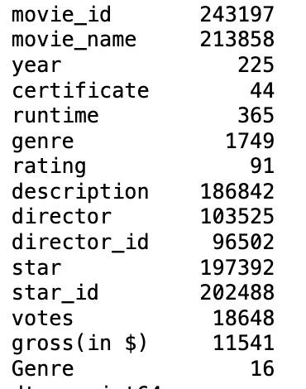
Data source
IMDB Source Data – pulled from Kaggle
16 separate CSV files – one for each genre
CSV files were combined into one data frame
368,300 rows & 15 columns

Slide 3
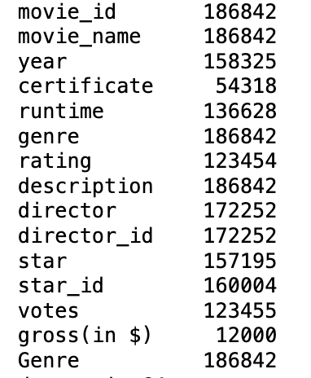
Data prep
Checked for null values in description, title columns
Removed duplicate values from data frame based on description
Over half the movies were left and used in a new data frame

Slide 4
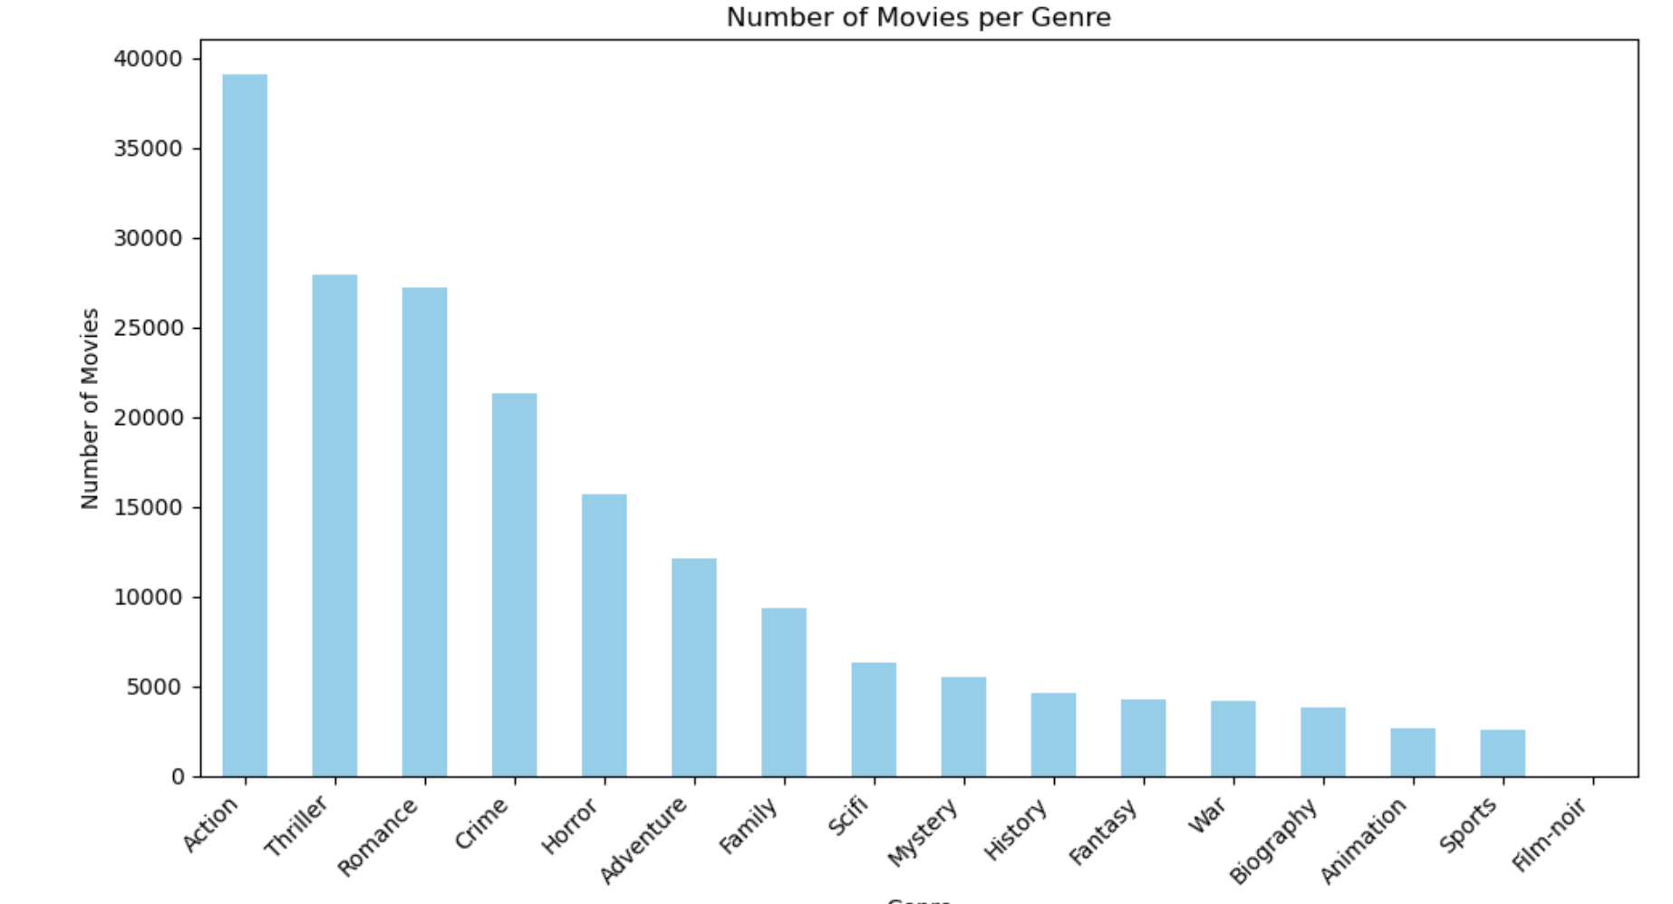
Count of Movies per genre

Slide 5
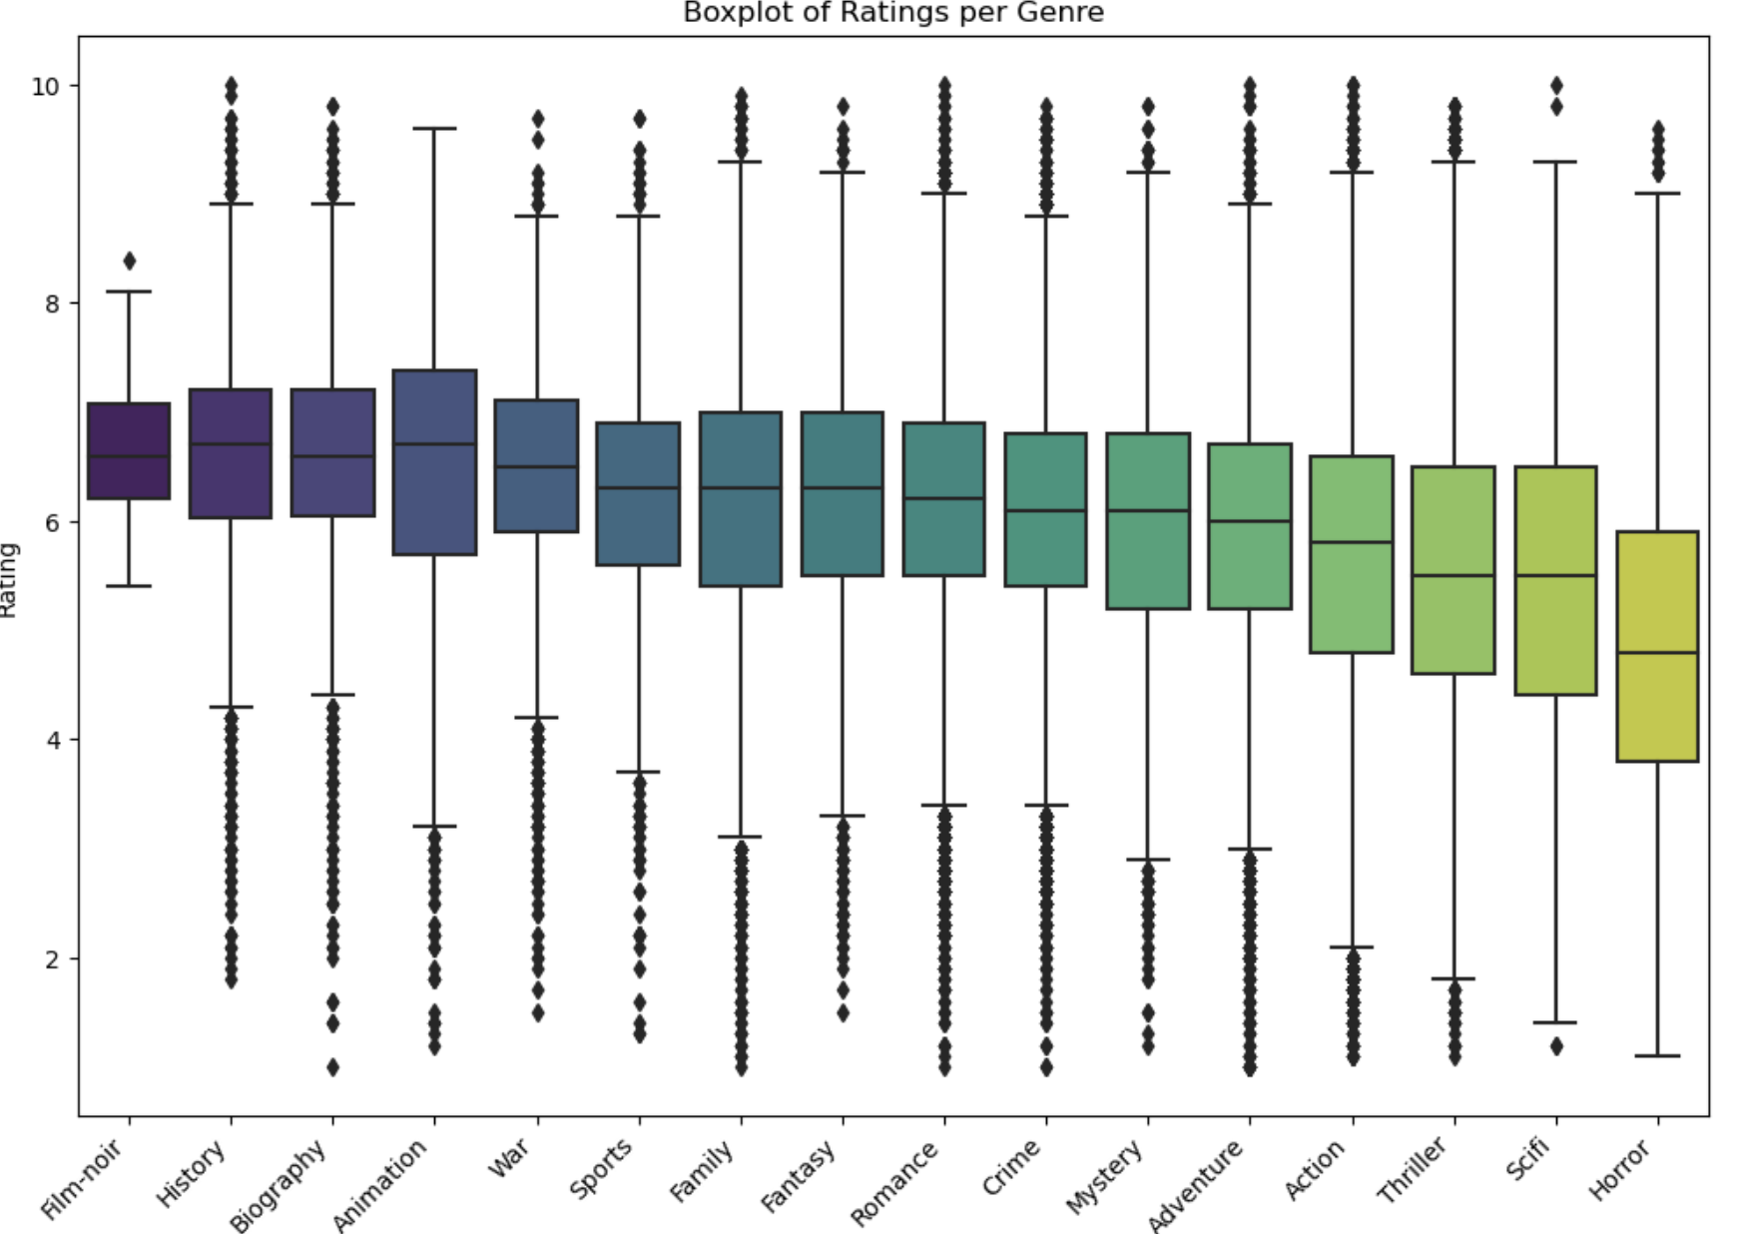
Ratings Per Genre

Slide 6
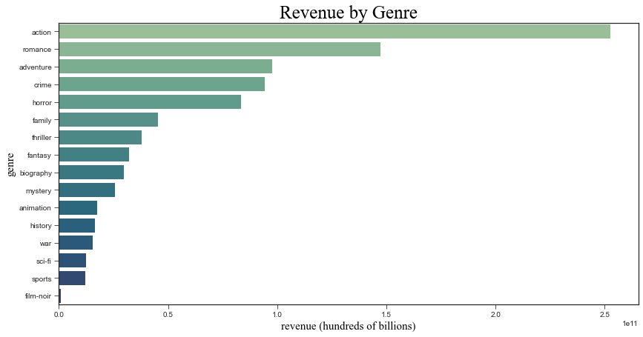
Revenue per genre

Slide 7
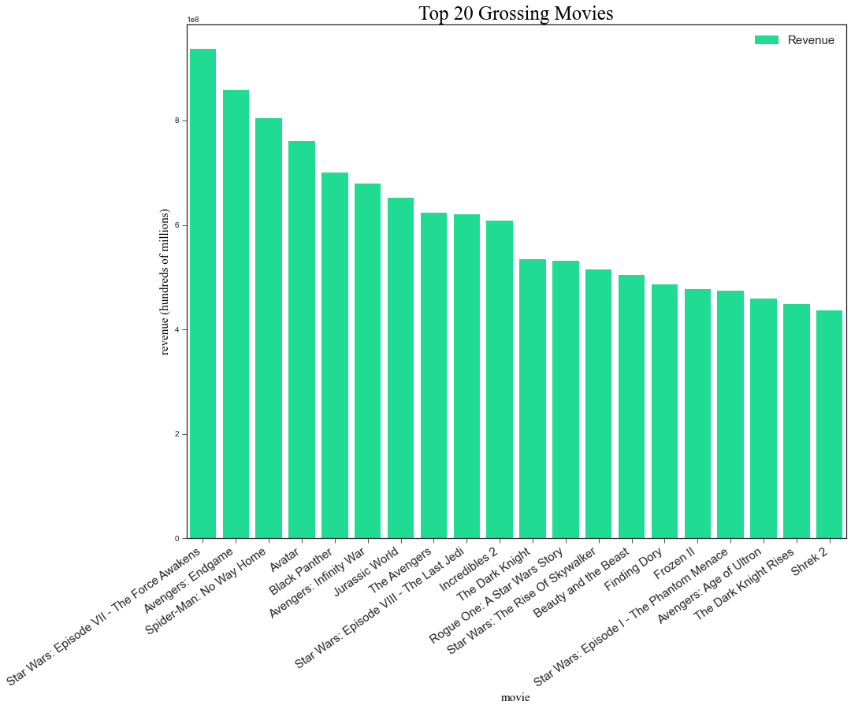
Top 20 Grossing Movies

Slide 8
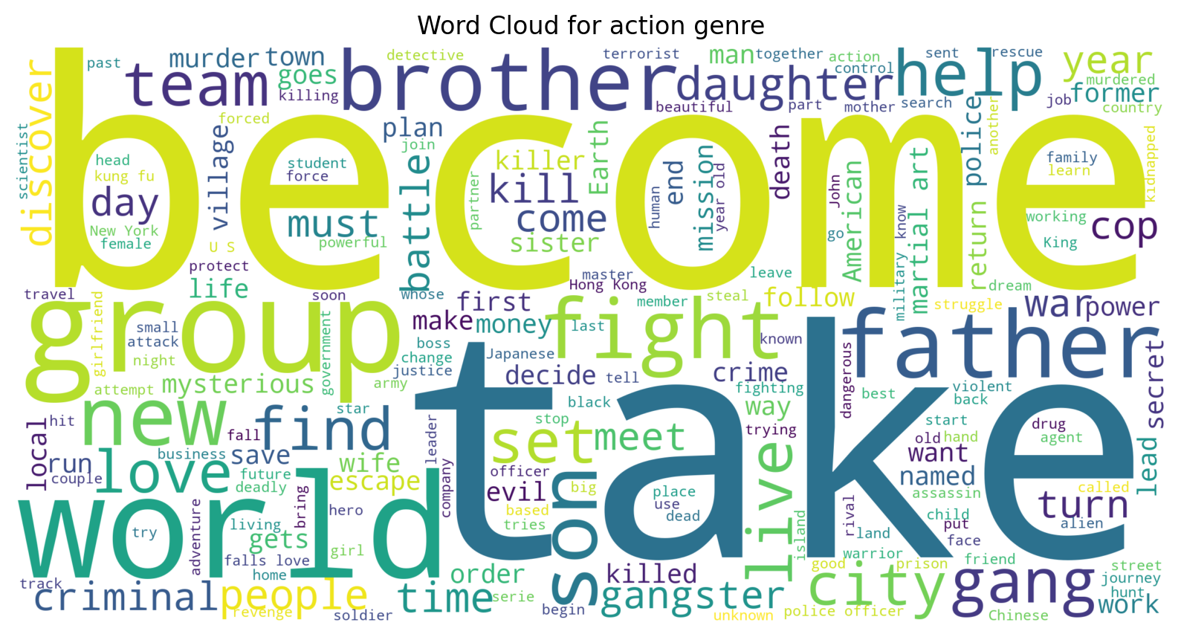
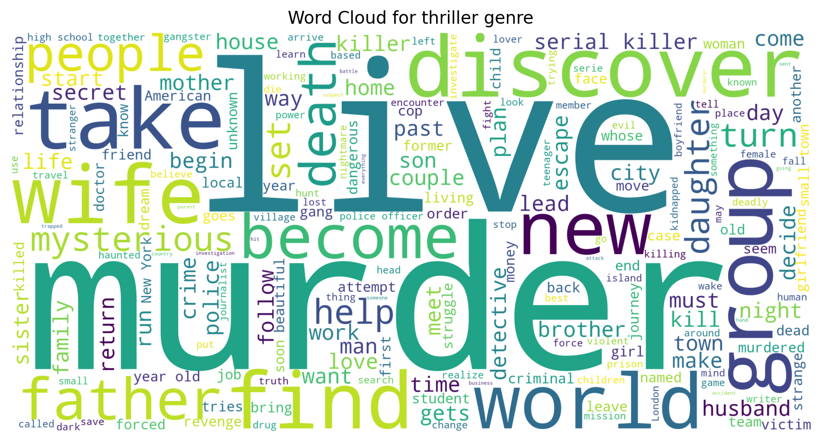
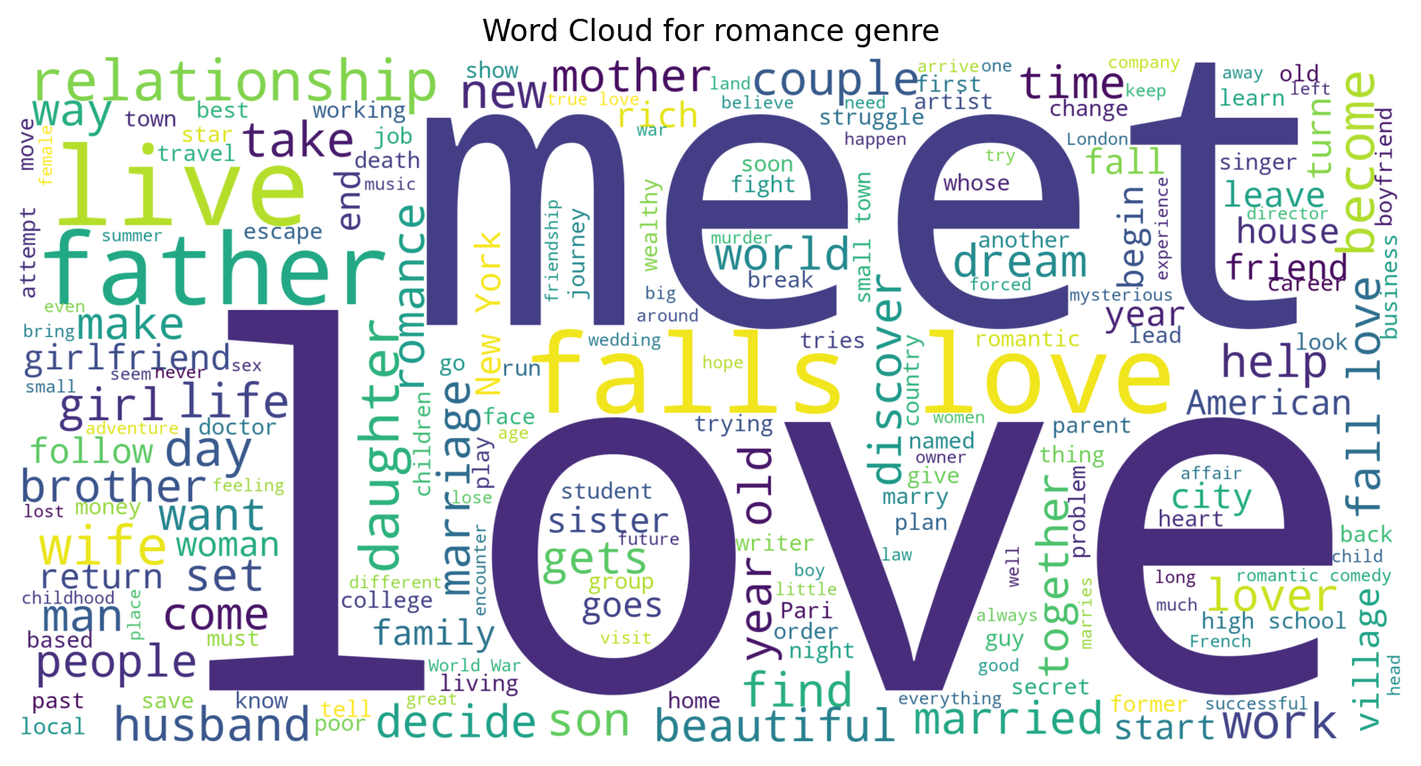
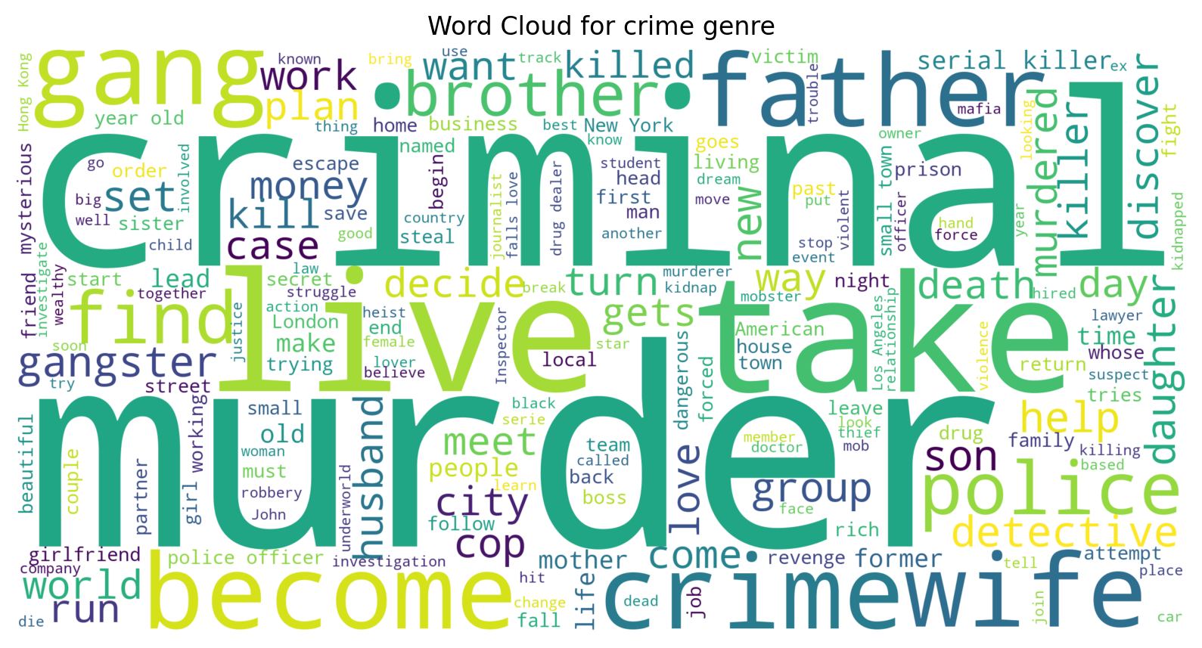
Word Clouds

Slide 9
Potential Issues
Multiple genres per movie
Features may cross over between genres

Slide 10
Models
Naïve Bayes
K Means Clustering
Random Forest
SVM

